Slide 2
Objectives
Describe the need for multimedia in HTML5
List the supported media types in HTML5
Explain the audio elements in HTML5
Explain the video elements in HTML5
Explain the accessibility of audio and video elements
Describe how to deal with non-supporting browsers

Slide 3
Introduction
Traditionally, Web browsers were capable of handling only graphics and text.
User had to install a distinct program, plug-in, or an ActiveX control to play some video.
Earlier, Web designers and Web developers used to set up Web pages to play audio and video on the Web using Adobe Flash player.
Multimedia is a combination of various elements such as video, graphics, sound, and text.
Common way of inserting a multimedia content on Web pages is by embedding a video or audio file in the Web page.
HTML5 has made lives easier by introducing <audio> and <video> elements

Slide 4
Supported Media Types in Audio and Video
Codec is a term referring to a device or a program used for encoding and decoding digital data stream
There are various video and audio codecs which are used for handling of video and audio files.
Different codecs have different level of compression quality.
For storing and transmitting coded video and audio together, a container format is used such as Ogg (.ogv), the Audio Video Interleave (.avi), Flash Video (.flv) …
Different browsers support different container format. WebM is a new open source video container format supported by Google.
^{Container} | ^{Video Codec} | ^{Audio Codec}
Mp4 | H.264 | AAC
Ogg | Theora | Vorbis
WebM | VP8 | Vorbis
Notes:
Codec: là thuat ngu dung de chi một thiết bị phan cung hoặc một chương trình phan mem có khả năng mã hóa và giải mã cac luong dữ liệu hoặc tín hiệu so. 'Compressor-Decompressor', 'Coder-Decoder', hoặc 'Compression/Decompression algorithm'.
Container format : dinh dang chua codec. 1 dinh dang chua codec bao gom 1 hay nhieu goi codec khac nhau cho am thanh, video hoac ca 2.
Mp4 : dinh dang cua bai hat co video
Avi :dinh dang cua miscrosoft (1992) – audio+ video codec (ko ho tro H.264)
FLV – Đây là Adobe Flash, hỗ trợ nhiều Codec khác nhau, phổ biến nhất là H.264 và AAC, là một trong những cách phổ biến nhất có thể xem được trực tiếp qua Internet. Một số thông tin cho biết Apple sẽ không cho phép Flash chạy trên bất kỳ thiết bị nào của họ.

Slide 5
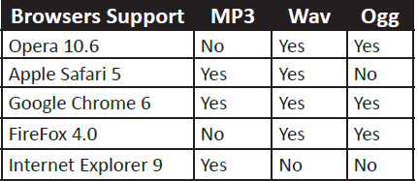
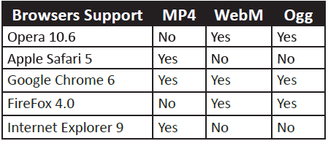
Audio & Video Formats
There are 3 supported file formats for the <audio> element in HTML5
There are the 3 supported file formats for the <video> element in HTML5.

Slide 6
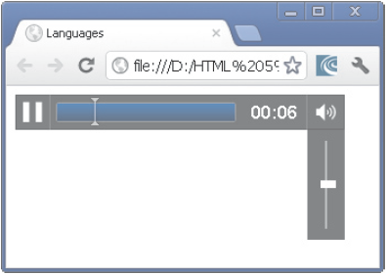
Audio Elements in HTML5
<audio> element allow to embed music on the Web site.
<!doctype html>
<html>
<head>
<title>audio element</title>
</head>
<body>
<audio src=”d:\audio.mp3”
controls autoplay loop>
html5 audio not supported
</audio>
</body>
</html>

Slide 7
Audio Tag Attributes
^{Audio Attributes} | ^{Description}
^{autoplay} | This attribute identifies whether to start or not the audio once the object is loaded
^{autobuffer} | This attribute starts the buffering automatically
^{controls} | This attribute identifies the audio playback controls that should be displayed such as resume, pause, play, and volume buttons
^{loop} | This attribute identifies whether to replay the audio once it has stopped
^{preload} | This attribute identifies whether the audio has to be loaded when the page loads and is ready to execute

Slide 8
Playing Audio Files in older Browsers
To play the audio in older browsers then the <embed> tag will be used.
<embed> tag has two attributes, src and autostart.
src attribute is used to specify the source of the audio.
autostart attribute controls the audio and determines whether the audio should play as soon as the page loads.
<audio autoplay loop>
<source src=”sampaudio.mp3”>
<source src=”sampaudio.ogg”>
<embed src=”sampaudio.mp3”>
</audio>

Slide 9
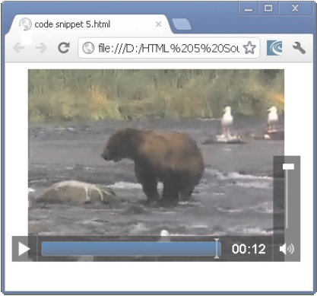
Video Elements in HTML5
is a new feature added in HTML5.
is for embedding the video content on the Web page.
if not supported by the browser then the content between the start tag and end tag is displayed.
src attribute is used to link to the video file.
<body>
<video src=”D:\movie.mp4”>
Your browser does not support the video.
</video>
</body>

Slide 10
Video Tag Attributes
HTML5 specification provides a list of attributes that can be used with the <video> element.
preload attribute that allows the browser to download or buffering the video while the Web page containing the video is being downloaded.
preload attribute has the following values: None, Metadata & Auto
^{Video Attributes}
autoplay
muted
controls
loop
preload

Slide 11
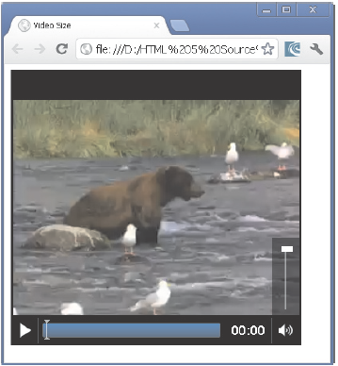
Setting the Video Size
Size of the video can be specified with the height and width attribute
If these attributes are not provided then the browser sets the video with the key dimensions of the video.
<style>
video{
background-color: black;
border: medium double black;
}
</style>
<body>
<video src=”D:\Codes\movie.mp4”
controls preload = ”auto”
width = ”360” height = ”340”>
Your browser does not support the video.
</video>

Slide 12
Converting the Video Files
There are many problems with browser vendors for supporting the various video formats on the Web sites.
Following are some of the video formats supported by the significant browsers:
Ogg/Theora - is an open source, royalty-free, and patent-free format available. This format is supported by browsers such as Opera, Chrome, and Firefox.
WebM - is a royalty-free and patent-free format supported by Google. This format is supported by browsers such as Opera, Chrome, and Firefox.
H.264/MP4 - are supported on iPhone and Google Android devices.
Micro Video Controller - converter creates all files that the user requires for HTML5 <video> element that works on the cross browser.
Notes:
Royalty-free, patent-free: mien phi ban quyen

Slide 13
Accessibility of Audio and Video Elements
Normally, Users can listen to the audio by using headphones or speakers.
Users can understand the language in which the media was delivered.
Users can successfully play and download the media.
However, sometime users cannot view or hear the media content because of their working environment or due to device restrictions.
Or they are not familiar with the language that the content is delivered.
Or when they have hearing and visual impairment, they cannot listen to the audio or view the video.
Or they have to use keyboards and screen readers to access the content on Web.

Slide 14
Track Element 1-3
Track element provides an easy, standard way to add captions, subtitles, chapters, and screen reader descriptions to the <audio> and <video> elements.
Track elements are also used for other types of timed metadata.
Source data for this track element is in a form of a text file that is made up of a list of timed cues.
Cue is a pointer at an accurate time point in the length of a video.
Cues contain data in formats such as Comma-Separated Values (CSV) or JavaScript Object Notation.
Track element is not supported in many major browsers and is now available in IE 10 and Chrome 18+.

Slide 15
Track Element 2-3
Following table lists the track element attributes.
^{Container} | ^{Description}
src | Contains the URL of the text track data
srclang | Contains the language of the text track data
kind | Contains the type of content for which the track definition is used
default | Indicates that this will be the default track if the user does not specifies the value
label | Specifies the title to be displayed for the user

Slide 16
Track Element 3-3
The Code Snippet demonstrates how a track element is used in combination with <video> element for providing subtitles.
<video controls>
<source src=”myvideo.mp4” type=”video/mp4” />
<source src=”myvideo.webm” type=”video/webm” />
<track src=”eng.vtt” label=”English subtitles” kind=”subtitles” srclang=”en” >
</video>
<video controls>
<source src=”myvideo.mp4” type=”video/mp4” />
<source src=”myvideo.webm” type=”video/webm” />
<track src=”de.vtt” label=”German subtitles” kind=”subtitles” srclang=”de” >
</video>

Slide 17
Summary
Multimedia is a combination of various elements such as video, graphics, sound, and text.
There are various media types used for audio and video files on different Web sites.
The <audio> element will help the developer to embed music on the Web site and allow the user to listen to music.
Users can play the audio in older browsers using the <embed> tag.
The <video> element is used for embedding the video content on the Web page.
Preload attribute identifies whether the audio has to be loaded when the page loads and is ready to execute.
WebM is a new open source video container format supported by Google.

